Slide 1

Project Oppenheimer
Noah Thederahn
Senior Thesis

Slide 2

OVERVIEW
Artificial Intelligence Agent to play Twilight Struggle
Agent will run inside of an application with a GUI

Slide 3
Twilight Struggle
“Now the trumpet summons us again, not as a call to bear arms, though arms we need; not as a call to battle, though embattled we are – but a call to bear the burden of a long twilight struggle...” – John F. Kennedy, 1961
Card-driven war game inspired by the Cold War
Gameplay breakdown

Slide 4
Motivation
Two Player board game lasting three hours
Number one rated game on BoardGameGeek.com
Few ways to play by oneself
Interest in AI

Slide 5
Project Components
GUI Application
AI Agent
Card Database
Game-state Representation

Slide 6
Application
Win32 type
Backbone which the rest my project will run on
Following a series of online tutorials

Slide 7
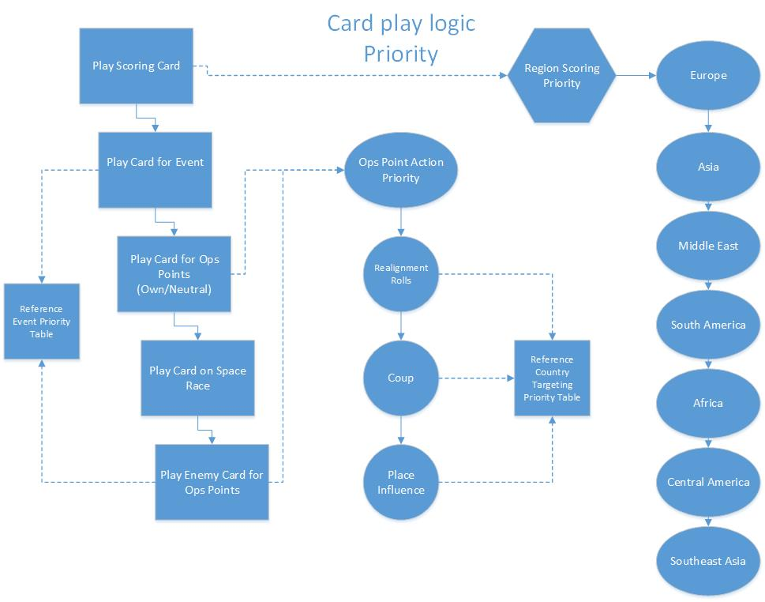
AI Agent
Decision Tree
Linear prioritization of certain elements
Will have a “near-perfect knowledge” of card location

Slide 8
Card Database
Stores all necessary card information
Implemented as a fixed length array
Cards will be indexed according to their unique ID number

Slide 9
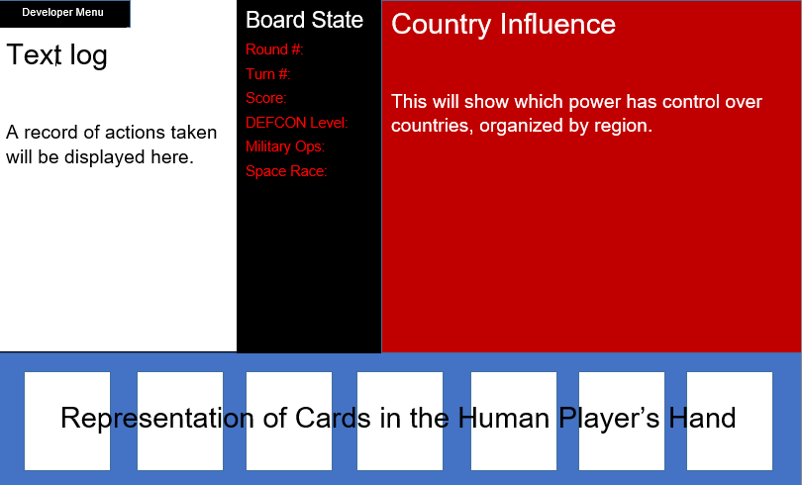
Game State
“Board” object keeping track of all game related information
Country adjacency will be tracked with a series of pointers

Slide 10
Progress/Preparation
Began tutorials working with Win32
Laid basic framework for logic sequence
Gathered resources for additional reference material
Informal decisions on implementation aspects

Slide 11
Goals
Have a program that is able to run independently
AI agent makes only occasional illegal moves, if any
Game can be played to time limit
Game-state correctly handles all relevant information and displays it in the GUI

